Slide 1

Predicting Olympic Medal Counts
Using Machine Learning and Deep Learning
By Balkrishna M Mottannavar

Slide 2
Project Overview
In this project, we will explore basic machine learning (ML) and deep learning (DL) techniques to predict the number of Olympic medals a country will win.
We will build and evaluate different models to understand which factors are most influential in predicting Olympic success.

Slide 3
About the Dataset
The dataset provided includes features such as:
iso: Country ISO code
ioc: International Olympic Committee code
name: Country name
continent: Continent of the country
population: Population of the country
gdp: Gross Domestic Product (GDP) of the country
olympics_index: An index indicating the country's overall performance in the Olympics
sports_index: An index indicating the country's sports infrastructure and support
olympicsIndex: A calculated index related to Olympic performance
sportsIndex: A calculated index related to sports
total: Total number of medals won
gold: Number of gold medals won
silver: Number of silver medals won
bronze: Number of bronze medals won

Slide 4
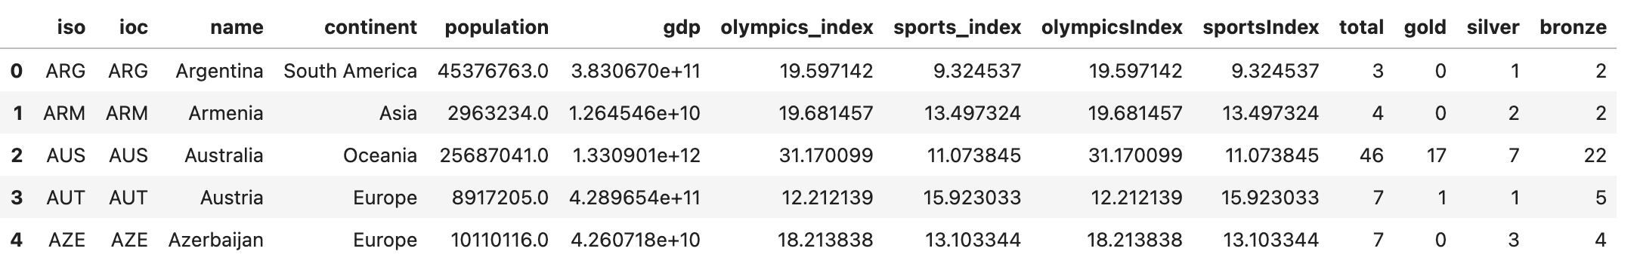
Data Preprocessing
Fig. First 5 Rows (out of 93) and 14 features of the Dataset
Feature Duplication:
In the above data we can clearly see that the features ‘olympicsIndex’ and ‘sportsIndex’ are the duplications of ‘Olympics_index’ and ‘sports_index’ respectively.

Slide 5
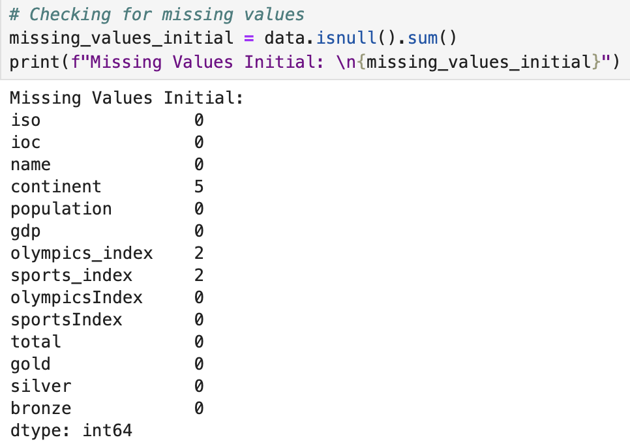
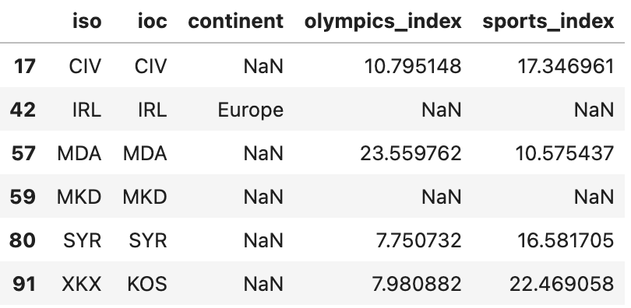
Data Preprocessing
Checking for any Missing Values
We can find that ‘continent’, ‘olympics_index’ and ‘sports_index’ Features have missing values

Slide 6
Data Preprocessing
Data Cleaning
Features | Cleaning Approach
Continent | Manually: As the name of the countries are provided under the feature called ‘name’ we can choose to fill the missing continent data manually with respect to their country names.
olympics_index Sports_index | K Nearest Neighbours: as these indices represents countries overall performance in olympics and countries sports infrastucture and support respectivelly, the best approach to fill in is Imputation Based on Similar Countries i.e., We could estimate the values based on countries with similar characteristics (e.g., GDP, population, or continent). This approach could provide more accurate imputations by considering factors that influence sports performance and infrastructure.

Slide 7
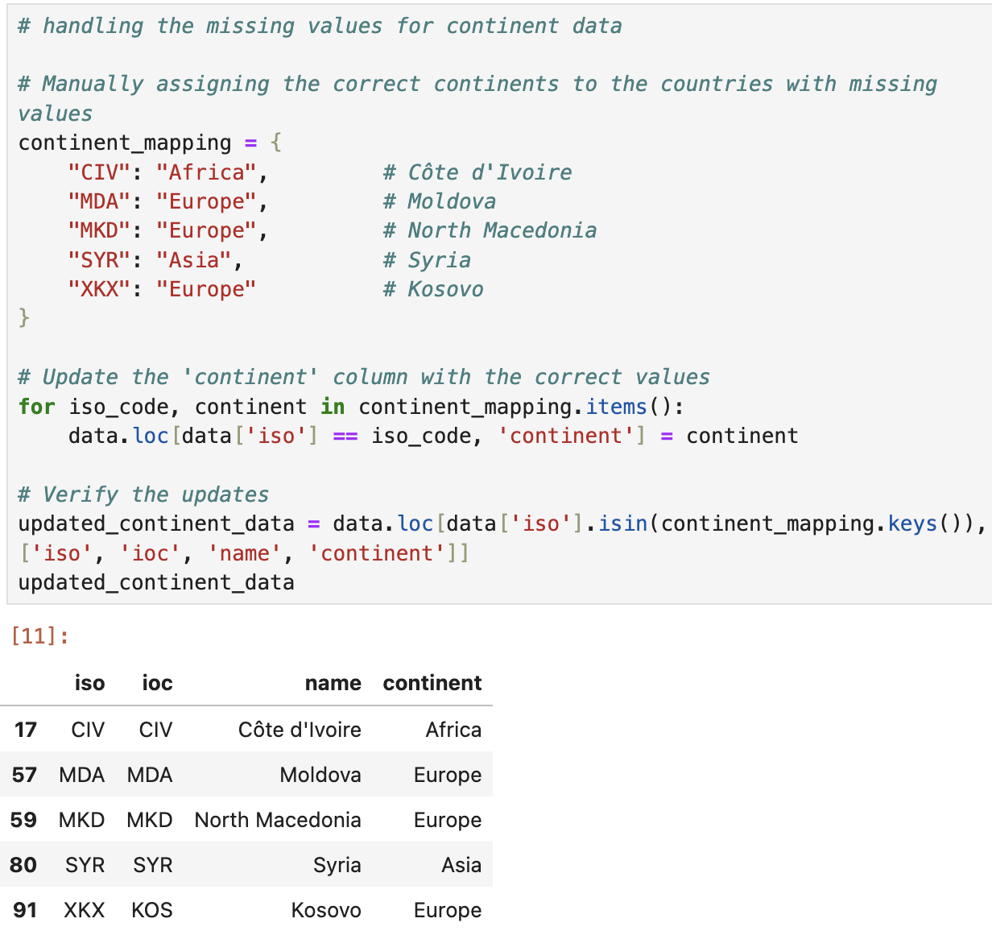
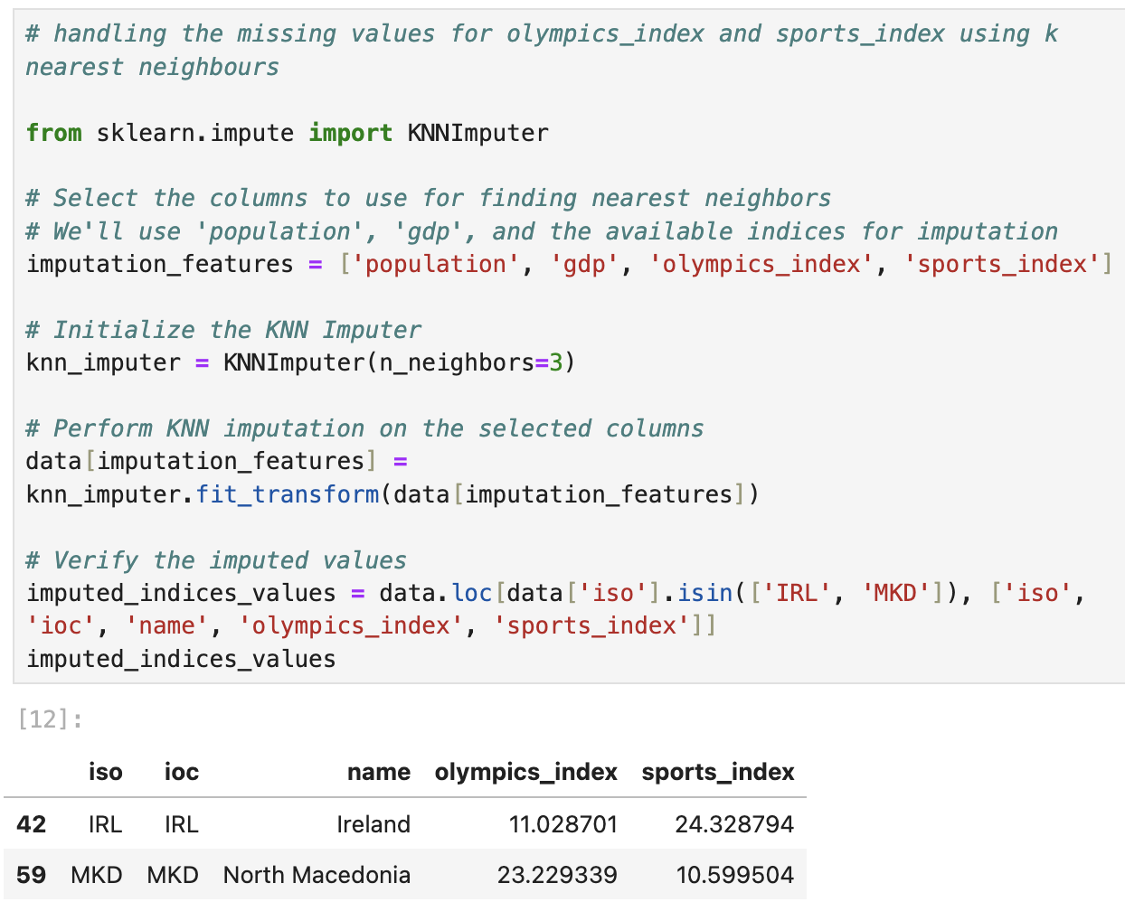
Data Preprocessing
Fig. ‘Continent’ Missing Data Filling Manually
Fig. ‘olympics_index’ and ‘sports_index’ Missing Data Filling using KNN

Slide 8
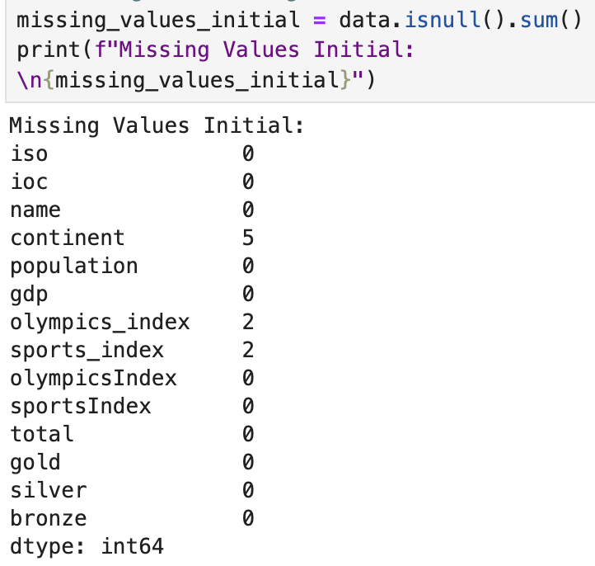
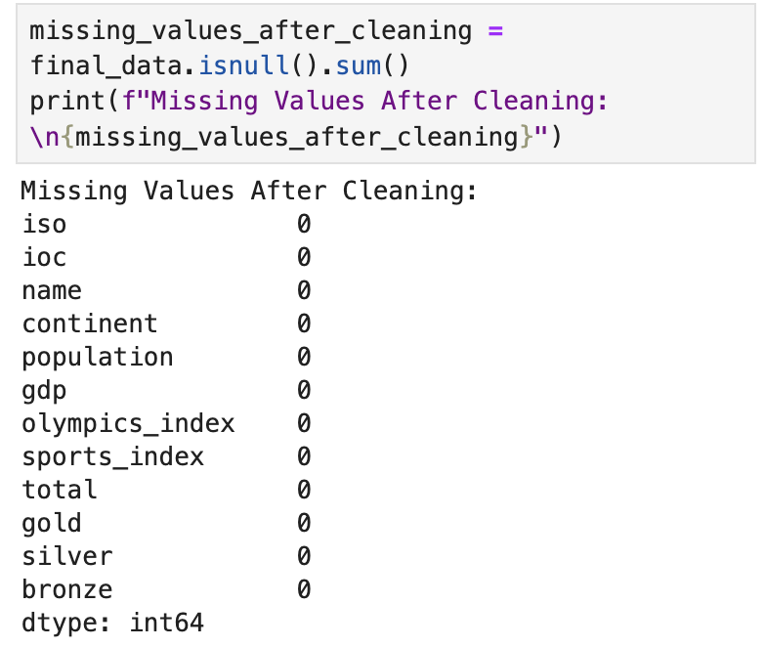
Verifying the Data Preprocessing
Fig. Before Data Preprocessing
Fig. After Data Preprocessing

Slide 9
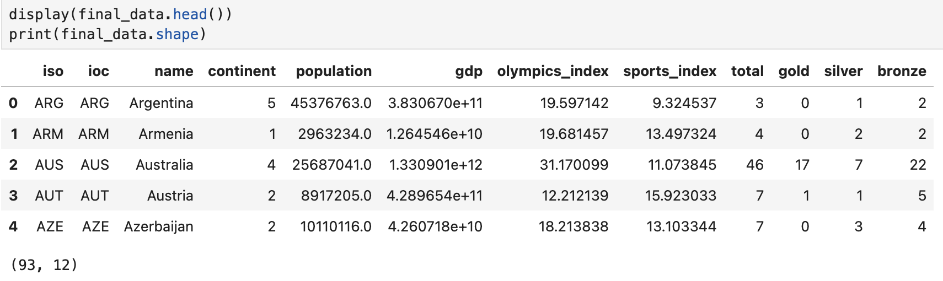
Verifying the Data Preprocessing
Fig. Final Data After Cleaning and Handling the Missing Values

Slide 10
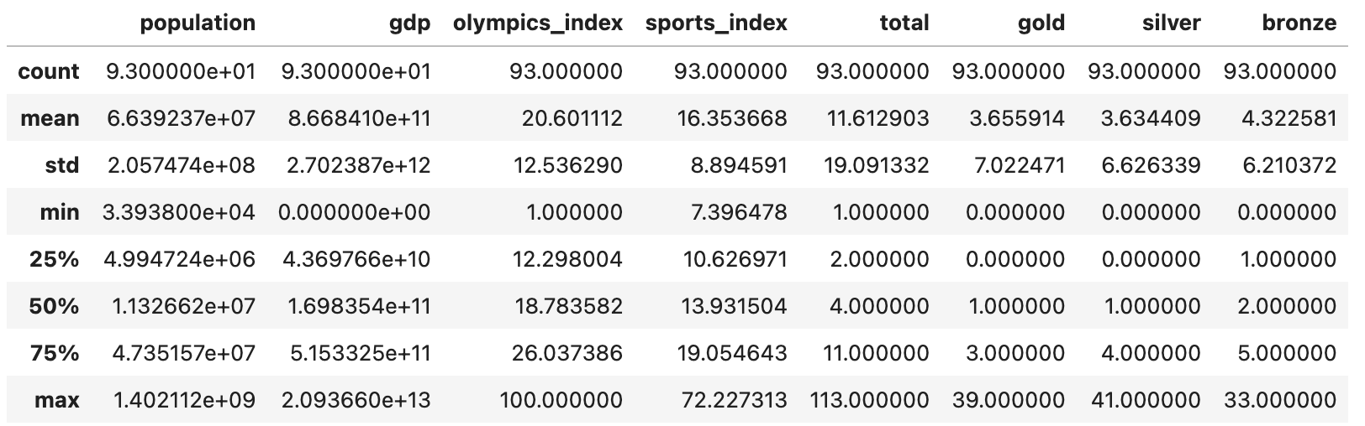
Exploratory Data Analysis (EDA)
Fig. Summary Statistics for Numerical Features of the Dataset

Slide 11
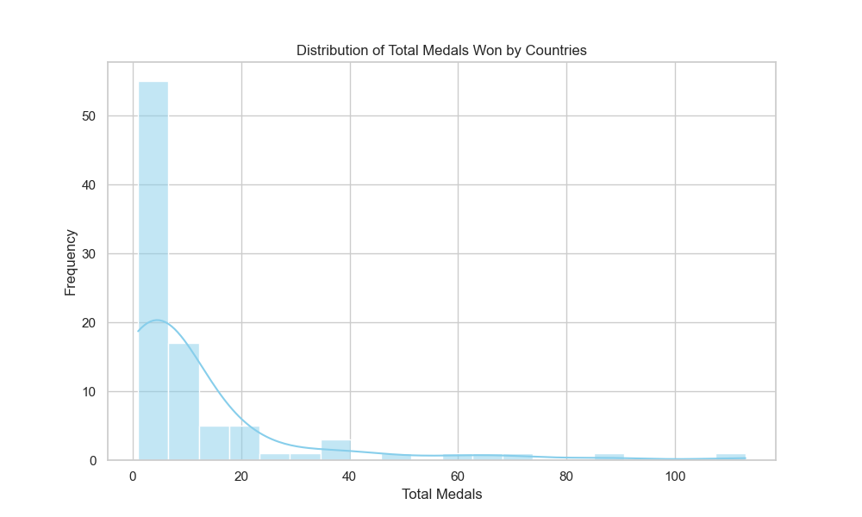
Data Visualization
Findings:
No medals or zero medals are won by most of the time.
0 to 20 medals are won more frequently.
This is because winning the medal is a rare scenario which comes at the cost of competition, countries’ funds over sports department for training and maintenance, and moreover the Olympics is not conducted very frequently but only once in every four years.

Slide 12
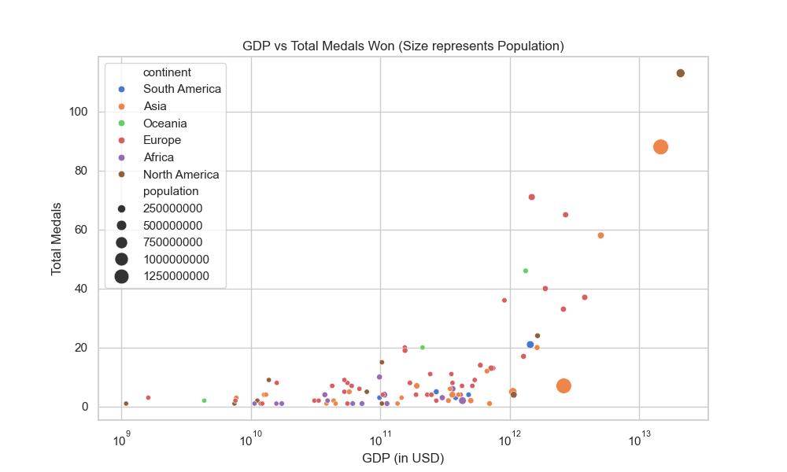
Data Visualization
Findings:
Highest GDP Continents won more medals than lower GDP Continents.
Hence GDP is found to be the impactful feature on number of medals won by a country.
The graph also shows a positive relationship between population and the medals won by the country.

Slide 13
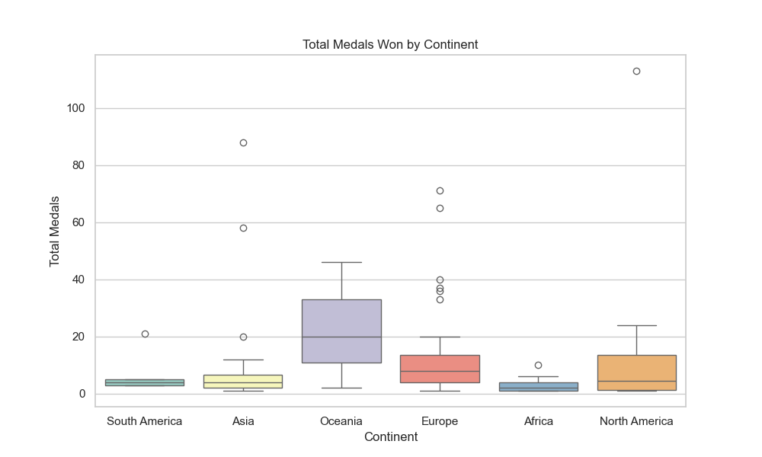
Data Visualization
Findings:
In support with GDP vs Total Medals won graph this also shows the higher GDP continents have won more medals.
We can find that Oceania has one the most medals but can also find huge outliers in North America, Europe, and Asia.
South America is the least continent that won the medals.

Slide 14
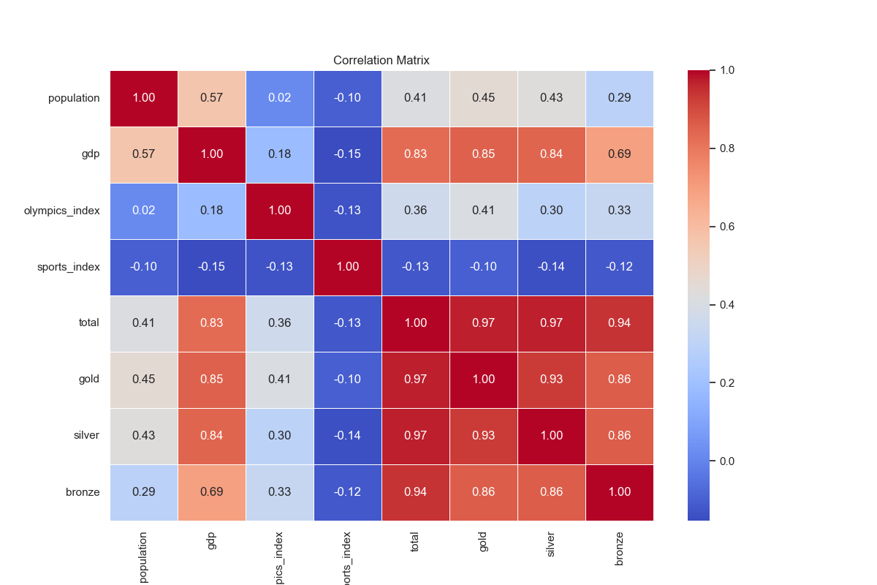
Data Visualization
Findings:
0.83 that 83% relationship between GDP and Total Medals won.
Followed by Population and Total Medals won which is 41%.
It is shocking that there is a poor relationship between sports_index and total medal won by that country i.e., -0.13. As this index indicates country’s sports infrastructure and support.

Slide 15

Machine Learning

Slide 16
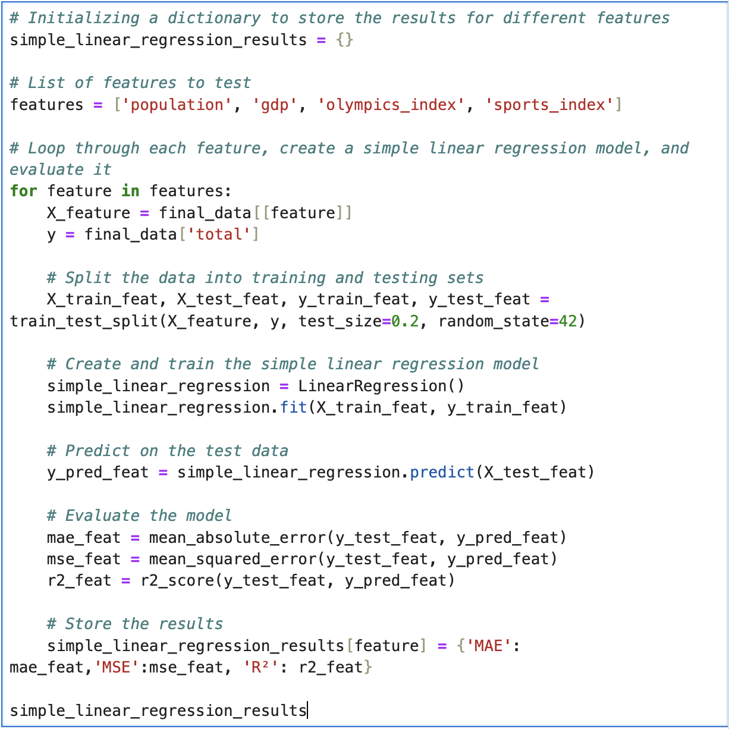
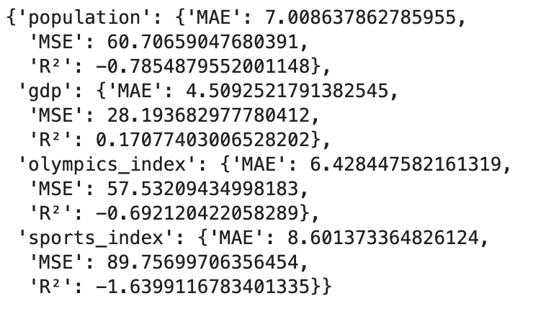
Simple Linear Regression
Fig: Simple linear Regression Output
Interpretation:
GDP appears to be the best single predictor among the features, with a positive R² value, though the overall predictive power is still limited.
Population and Olympics Index have slightly better performance than Sports Index, but they still do not explain much of the variance.
Fig: Simple Linear Regression Code Snippet

Slide 17
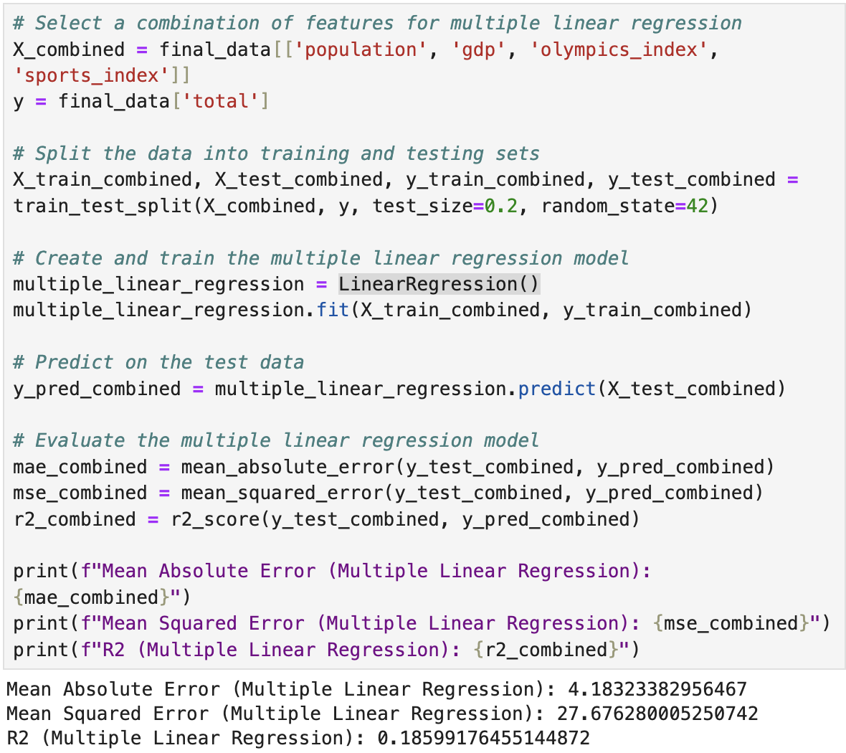
Multiple Linear Regression
Interpretation:
Improved MAE: The MAE has improved compared to the individual feature models, indicating that the combined model is more accurate in predicting the total number of medals.
Positive R² Score: The R² score of 0.18 suggests that the combined model explains around 18% of the variance in the total number of medals, which is an improvement over the individual models but still leaves a lot of unexplained variance.
Conclusion:
The multiple linear regression model using a combination of features provides a better fit and more accurate predictions than models using single features alone. However, the relatively low R² score indicates that there may be other important factors not captured by the current features.
Fig: Multiple Linear Regression Code Snippet and Output

Slide 18
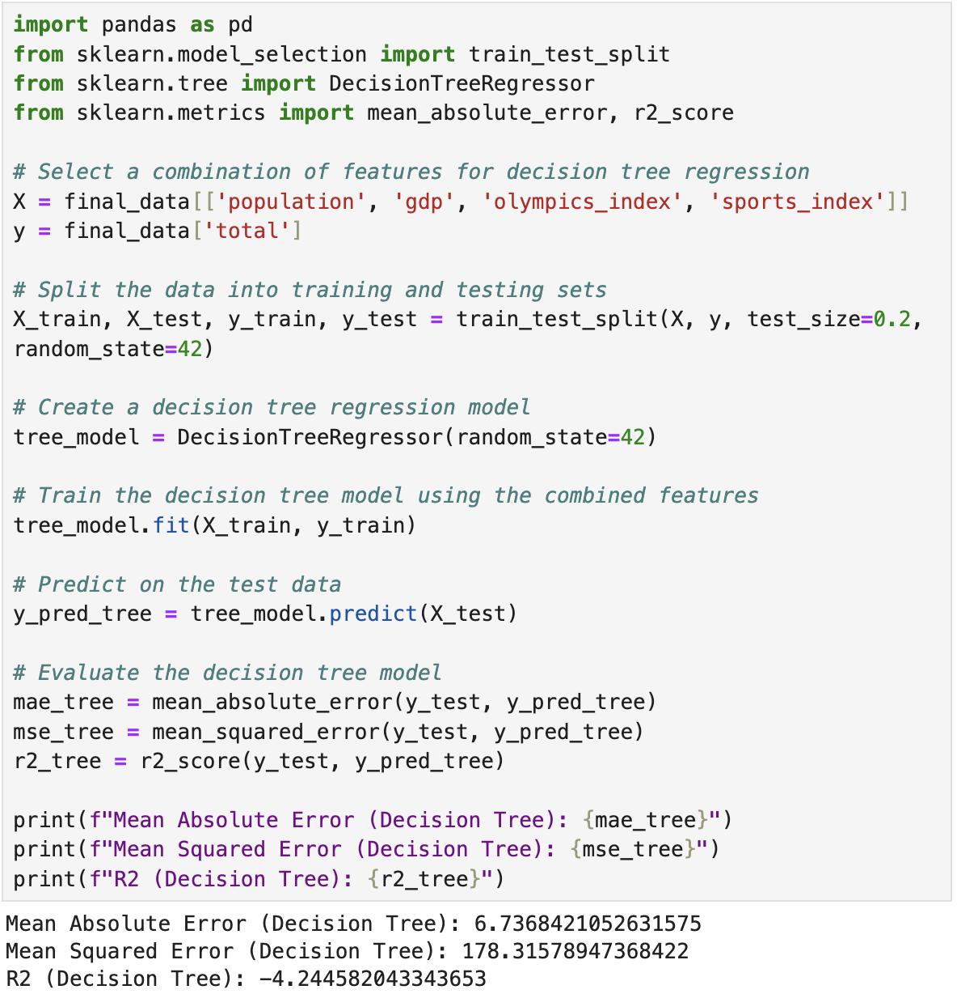
Decision Tree Regression
Interpretation:
The negative R² score suggests that the model is performing poorly, significantly worse than a simple mean prediction.
Overfitting: The decision tree model may have learned the training data too well, capturing noise rather than the underlying pattern. This often leads to poor performance on unseen data.
Non-linear Relationships: Although decision trees can model non-linear relationships, the current setup might not be optimal for this dataset, leading to poor generalization.
Fig: Decision Tree Regression Code Snippet and Output

Slide 19
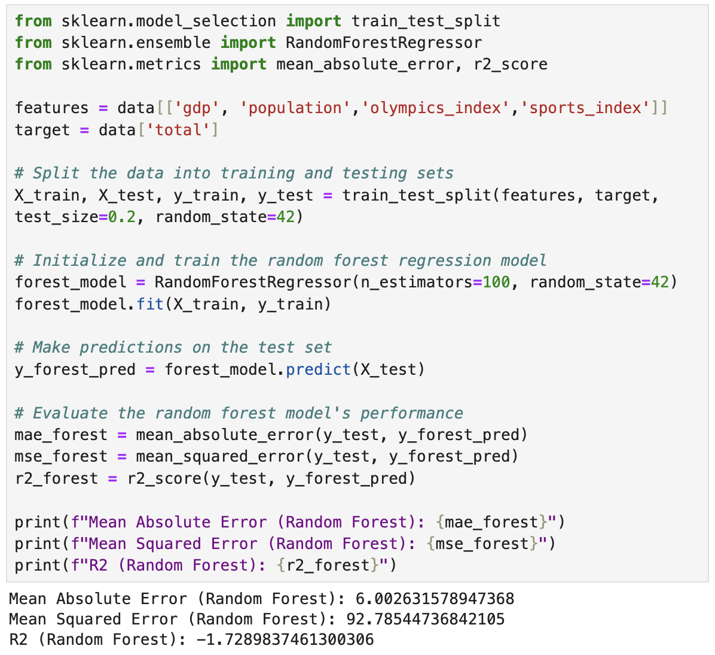
Random Forest Regression
Interpretation:
Improved MAE: The MAE of 6.73 is an improvement over the decision tree model's MAE of 6.00, indicating that the random forest model is more accurate in predicting the total number of medals.
Negative R² Score: The R² score is still negative (-1.72), which suggests that while the model has improved in accuracy, it is still not generalizing well to the test data. This could indicate that the model may still be overfitting or that the features used are not sufficiently capturing the underlying patterns.
Fig: Random Regression Code Snippet and Output

Slide 20
Deep Learning

Slide 21
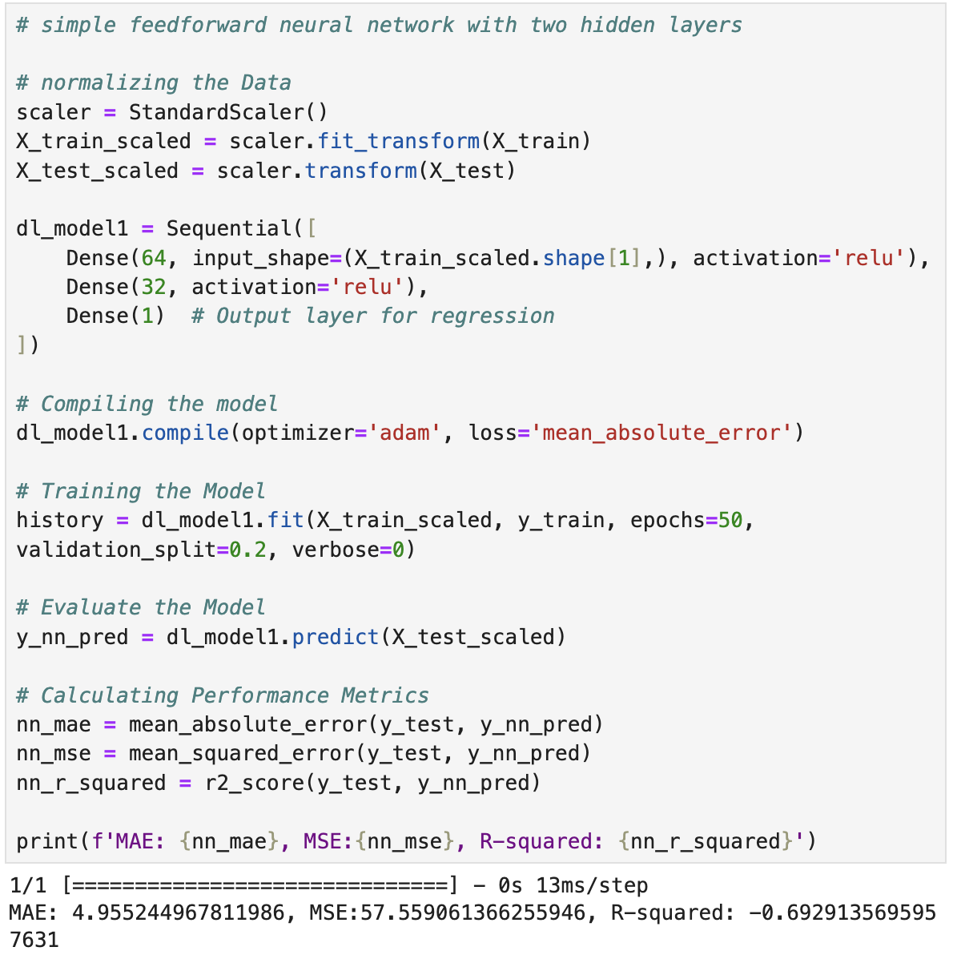
Artificial Neural Network (ANN)
Interpretation:
Increase in model performance from previous Random Forest Model i.e., MAE from 60% to 49%.
R² score also approached near zero but still in negative value.
Fig: ANN Code Snippet and Output

Slide 22
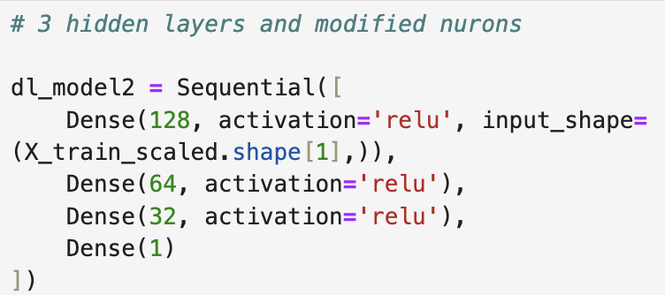

ANN – Experimenting with different Architectures
We can find improved MAE and R² value
Adding 3rd hidden layer increases the network’s capacity to learn from the data. With more layers, the network can store more information, which might be necessary for accurately modeling complex datasets.
hidden layer typically applies a non-linear transformation (e.g., ReLU activation), allowing the network to model non-linear relationships between inputs and outputs more effectively.
Fig. ANN with 3 hidden layers and modified nurons with its output

Slide 23
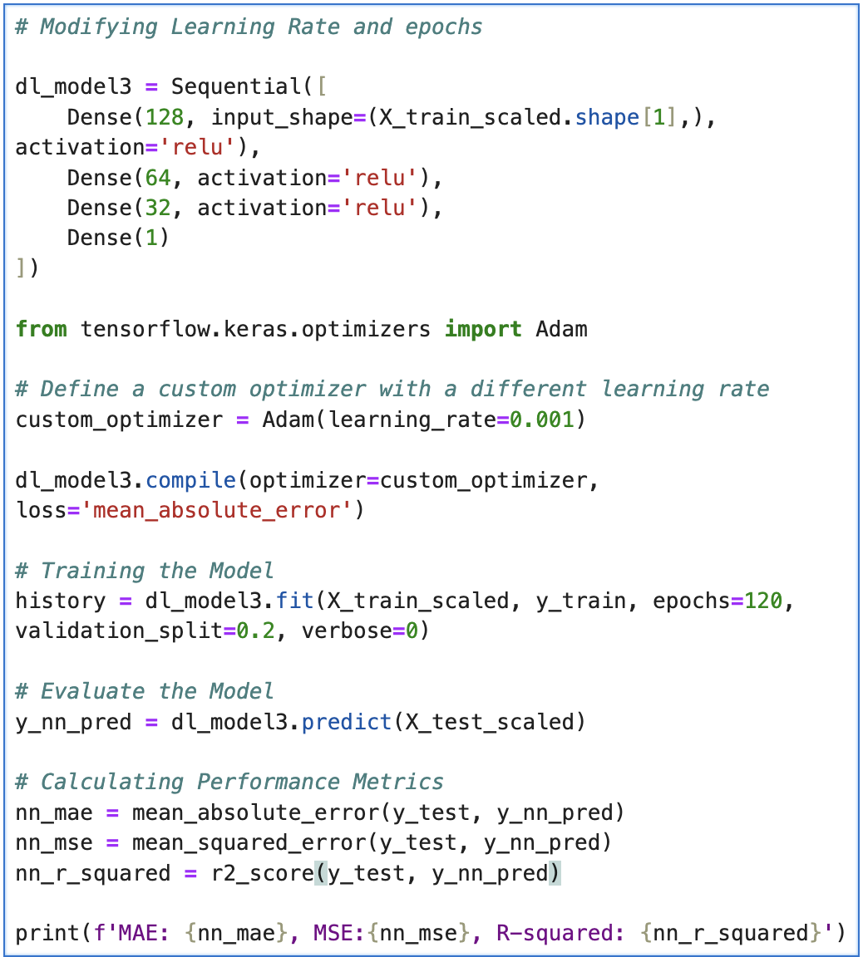
Hyperparameter Tuning
The learning rate was set to 0.001 and epochs was set to 120 from 100.
We can encounter the better MAE i.e., 38% and positive R² score.
learning rate is a hyperparameter that determines the size of the steps the model takes when updating the weights in response to the calculated gradient during training. Reducing the learning rate as training progresses, can help the model fine-tune the weights as it gets closer to the optimal solution.
The number of epochs is the total number of passes the model makes through the data during training. The optimal number of epochs allows the model to learn enough from the data to generalize well to new data without overfitting.
Fig. Further Modification in Learning Rate and Epochs

Slide 24
Model Comparison
Models | MAE | MSE | R²
ANN Learning rate = 0.001 Epochs = 120 | 3.85 | 33.15 | 0.024
Multi Linear Regression | 4.18 | 27.68 | 0.19
ANN 3 hidden layers | 4.22 | 43.75 | -0.29
ANN 2 hidden layers | 4.95 | 57.55 | -0.69
Random Forest Regression | 6.00 | 92.79 | -1.73
Decision Tree Regression | 6.74 | 178.31 | -4.24

Slide 25
Model Comparison
By above table we can conclude that the ANN model after Hyperparameter tuning performs better than among all the models we tested.
Decision Tree Regression Model performs poorly among all.
Random Forest Regression Model performs better than Decision Tree Regression Model.

Slide 26
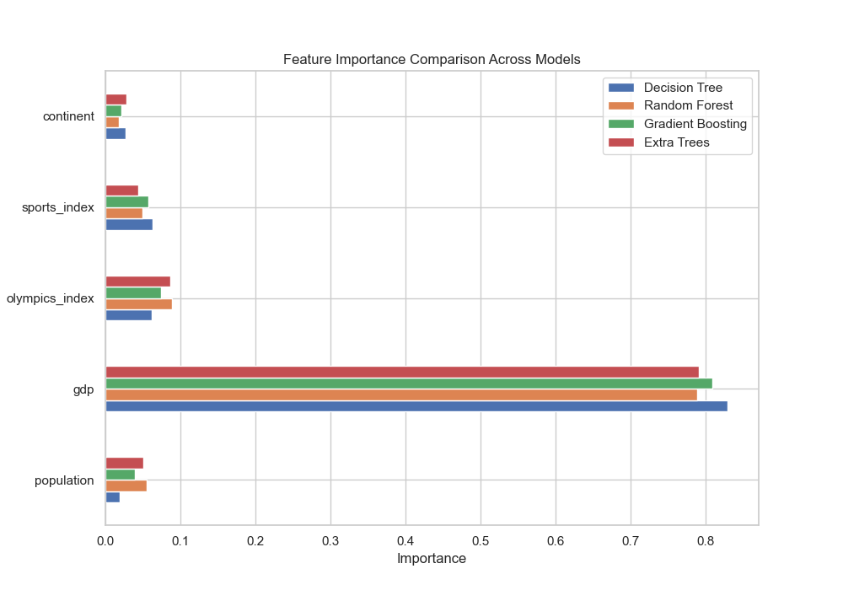
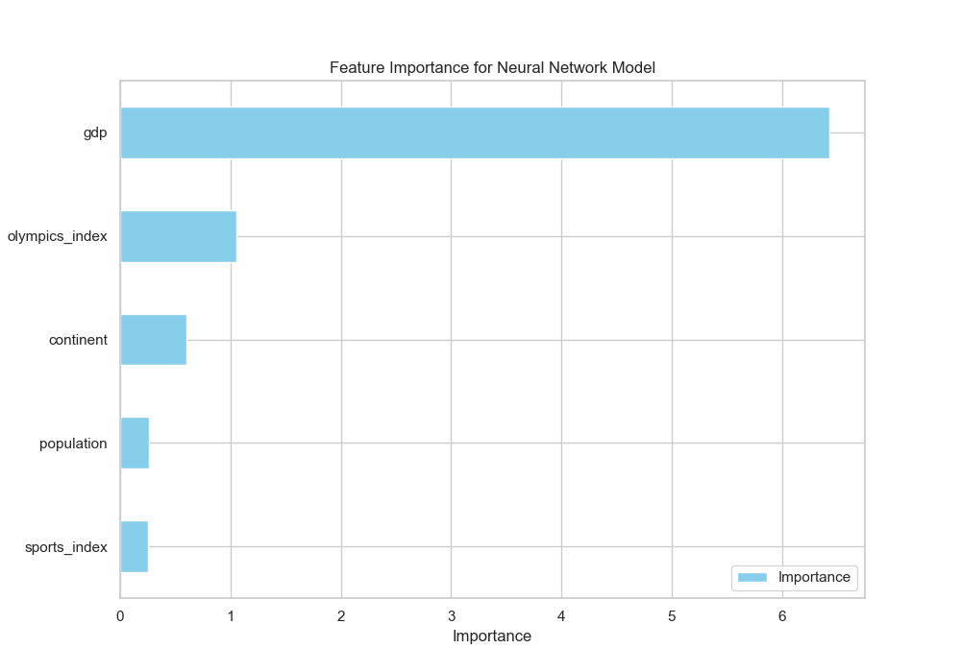
Feature Importance
Fig. Feature Importance by Machine Learning Models
Fig. Feature Importance by Neural Network Model

Slide 27
Feature Importance
Findings:
GDP is the most significant factor in determining a country’s medal-winning potential
followed by the Olympics Index, which reflects overall sports performance, and then population size.

Slide 28
Model Interpretation
We can conclude that countries with a higher GDP tend to win a greater number of Olympic medals. As a country's GDP increases, more funds can be allocated across various sectors, including sports. This enables the government to invest more in sports infrastructure, equipment, coaching, and overall athletic development. Consequently, these improvements can enhance the country's performance in the Olympics, potentially leading to the winning of more medals.
We can conclude that, in addition to GDP, a country's overall performance in sports, as indicated by the Olympics Index, is the second most important factor in winning Olympic medals. A higher Olympics Index reflects a strong and consistent performance across various sports disciplines. As a country's GDP increases, it enables more investment in sports infrastructure, coaching, and athlete development, which in turn improves the country's overall sports performance. This enhanced performance, as captured by the Olympics Index, significantly contributes to the likelihood of winning more Olympic medals.

Slide 29
Way Forward
To enhance a country's chances of winning more Olympic medals, it is crucial to focus on the following areas:
Economic Growth: Continue to strengthen the economy, as a higher GDP enables greater investment in sports infrastructure, training facilities, and athlete support programs.
Investment in Sports Performance: Prioritize improving the Olympics Index by investing in talent identification, development programs, and international competition exposure. This will help to elevate the overall sports performance of the country.
Population Engagement: encouraging widespread participation in sports at the grassroots level. This can be achieved through initiatives that promote physical education, community sports programs, and national sports campaigns to discover and nurture talent from a larger pool.
Strategic Allocation of Resources: Allocate resources strategically across different sports, focusing on areas where the country has traditionally excelled, while also identifying and supporting emerging sports with high medal potential.

Slide 30

Thank you

